Slide 1
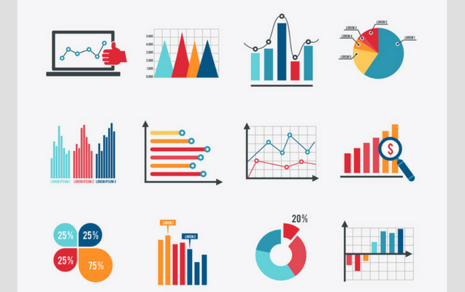
Presentation
on Various Types of Data Visualization Plots

Slide 2
Names of Plots
Area Plot
Swarm Plot
Density Plot
PC
SunBurst Chart
Timeline

Slide 3
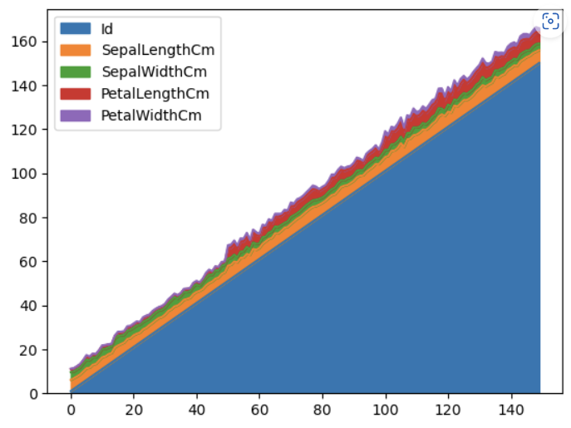
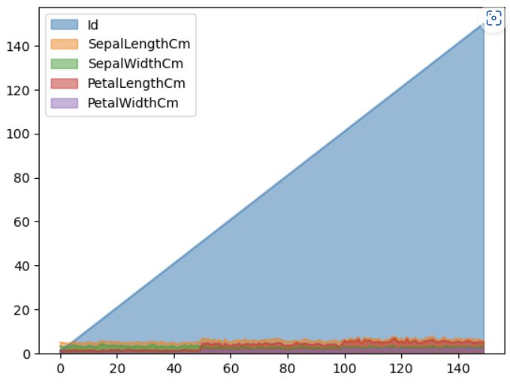
AREA PLOT
This Plot is used for Multiple variate data.
This plot comes under Numerical vs Numerical.
Area chart is an extension of a line graph .
It combines the line chart and bar chart to compare the values of groups.
Area Plots are stacked by default.
To produce stacked area plot, each column must be either all positive or all negative values.
To produce an unstacked plot, pass stacked=False.
This chart is communicate Over all trend not individual values

Slide 4
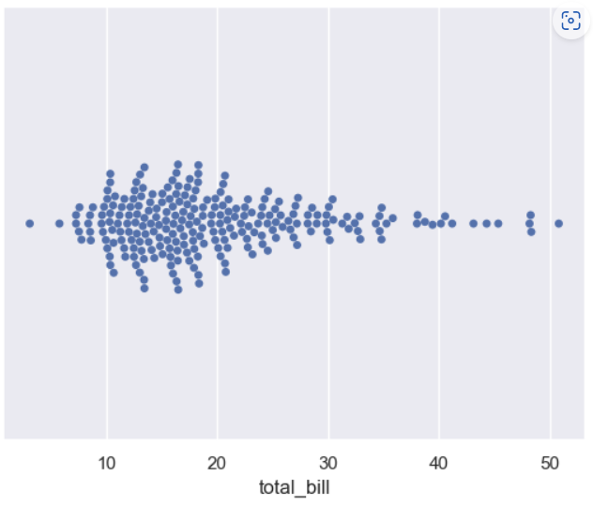
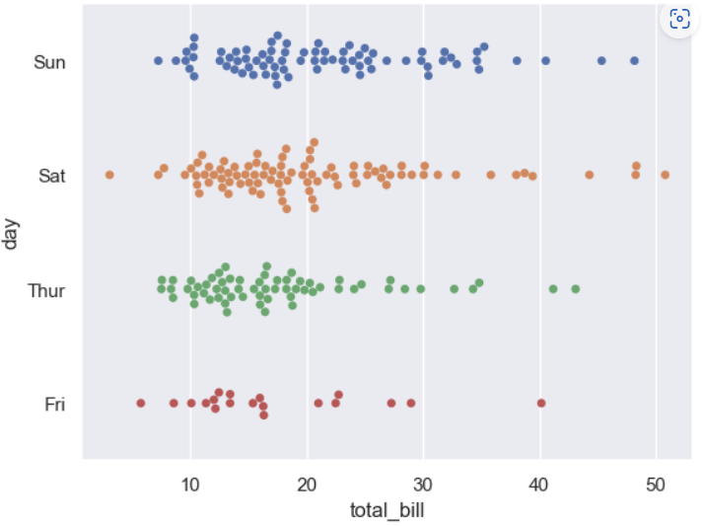
Swarm Plot
This plot used for Univariate , Bivariate and Multivariate data.
This Plot comes under Categorical vs Numerical.
Swarm plot can be drawn on it’s own.
This plot represent the implementation of a Scatter Plot for a Categorical variable.
This plot is just like strip plot but the difference is that the points are adjusted so that the points don’t overlap.
This plot gives better representation than strip plot.
Sometimes This plot is also called as BeeSwarm.

Slide 5
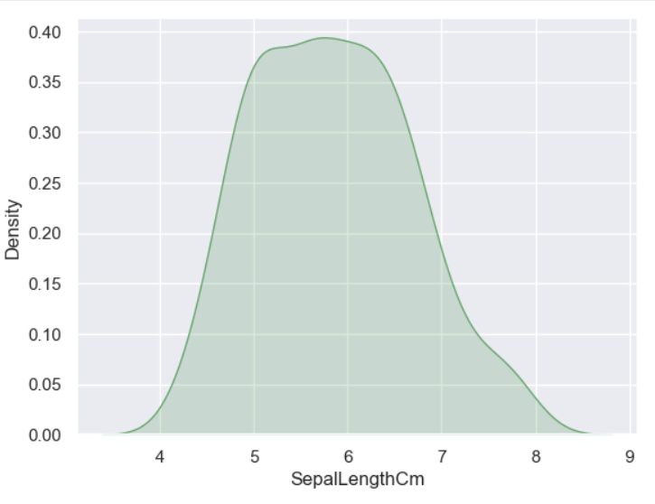
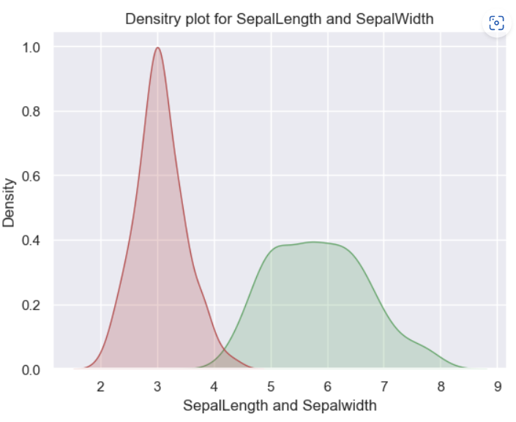
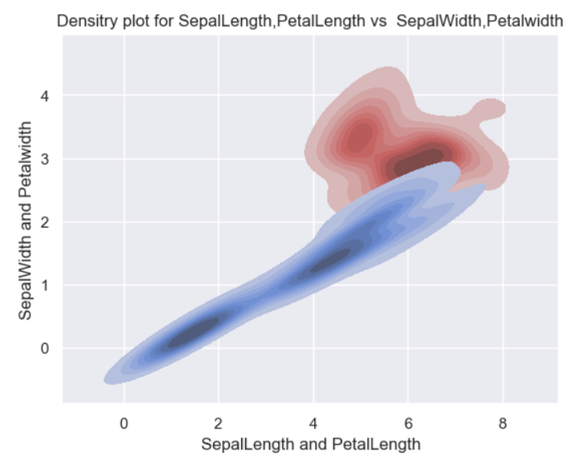
Density Plot
Density Plot is used for Univariate and Bivariate and Multivariate.
Density Plot comes under Numerical vs Numerical
Density plots are used to visualize The distribution of numerical variable for one or more groups.
These plots are very well adapted for large data sets.
This Density Plot is also called KDE Plot.
KDE stands for Kernel Density Estimate.

Slide 6
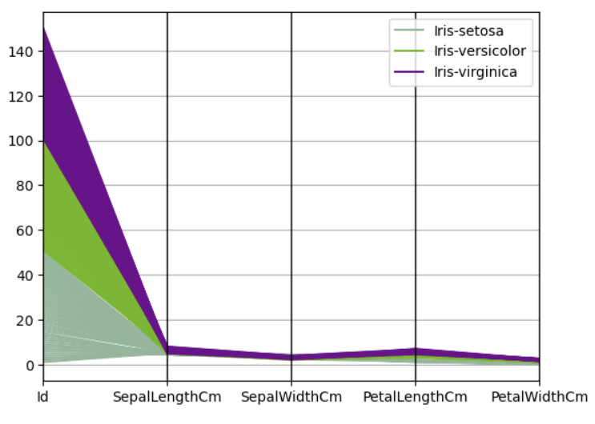
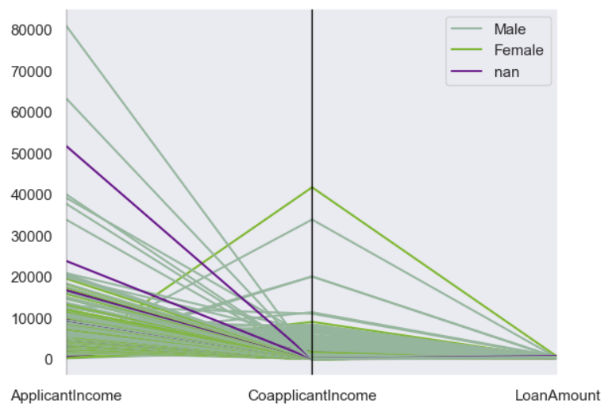
Parallel Coordinates
Parallel Coordinates is a plotting technique used for plotting Multivariate data.
Parallel Coordinates comes Numerical Vs Numerical .
Parallel Coordinates are Ideal for comparing Many values together and analyse how the relationship between them
Parallel Coordinates allows one to see clusters in data and estimate other statistics visually.
Using Parallel Coordinates, points are represented as connected line segments.
One set of connected line segments represents one data point.
Points that tend to cluster will appear closer together.

Slide 7
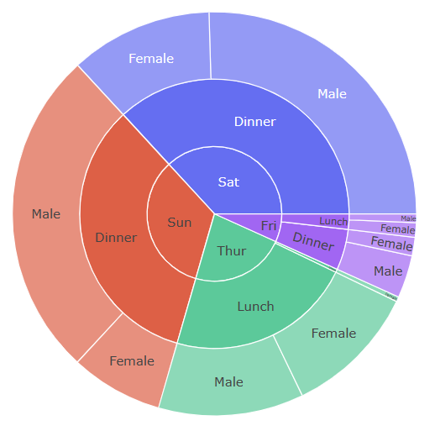
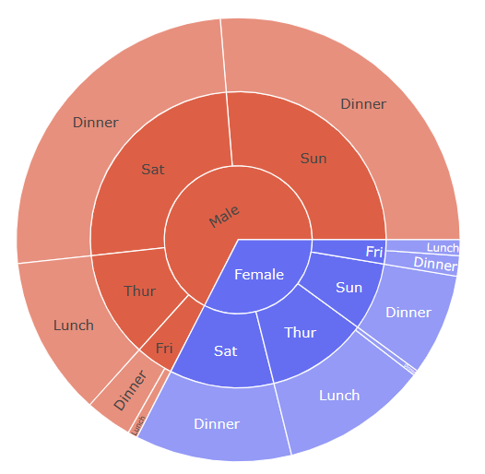
SunBurst Chart
This chart is used for multivariate Data.
This Chart comes under Categorical vs Numerical Category.
SunBurst Chart visualizes Hierarchical data spanning outwards radially from roots to leaves.
The hierarchy is defined by labels and parents attributes.
The root starts from the center and the children are added to the outer rings.

Slide 8
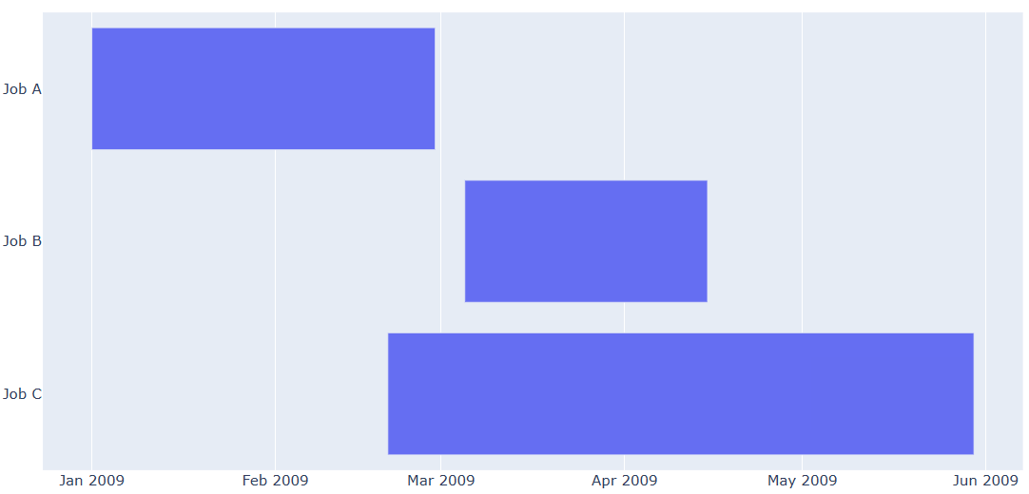
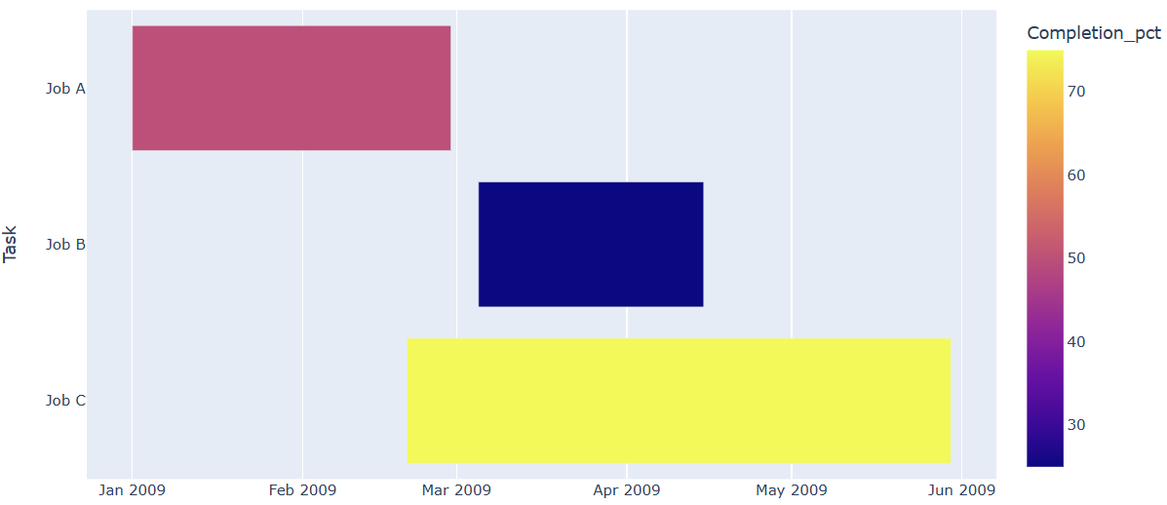
TimeLine Chart
This chart used for Bivariate data.
This chart comes under Numerical vs Categorical.
A Timeline chart visualizes an important events over a time span.
Charts with a Timeline series display every data point as a separate event along a horizontal or vertical line.
The Chart lists the tasks to be performed on the vertical axis and time intervals on horizontal axis.
With this function each data point is represented as a horizontal bar with star and end point specified as dates.

Slide 9
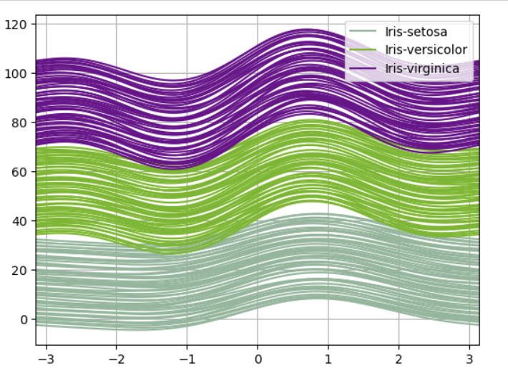
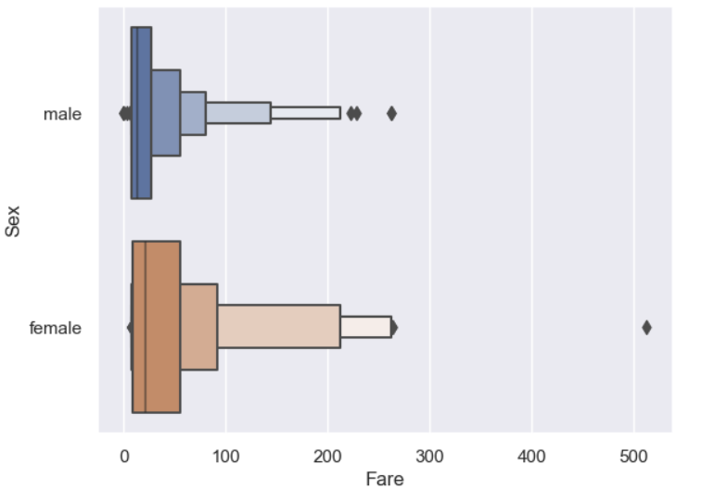
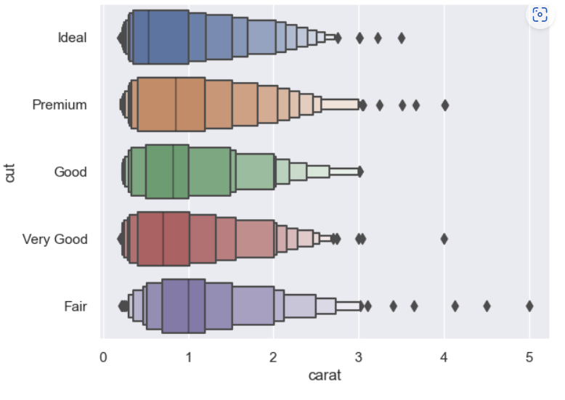
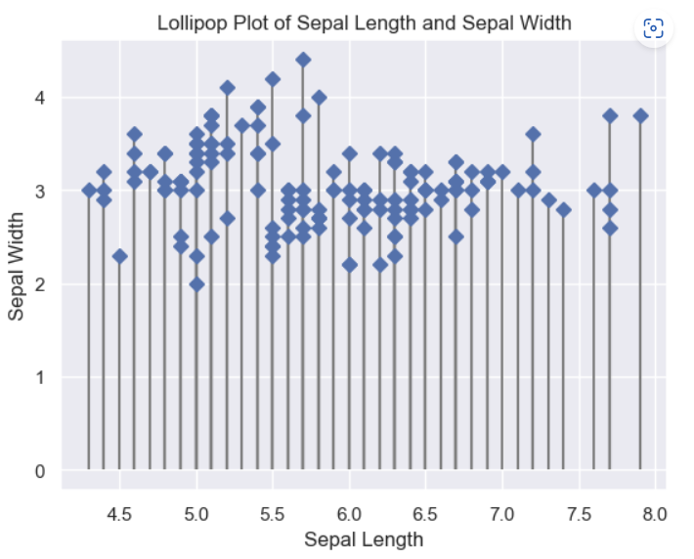
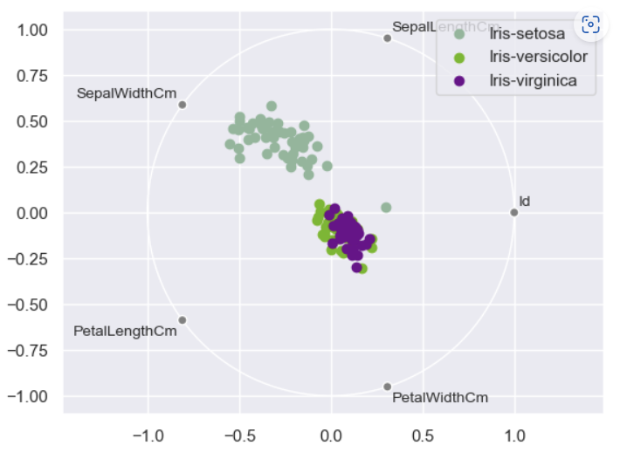
Andrew Curves
Boxen Plot
LolliPop Plot
Rad Viz Plot

Slide 10


